Slide 1
Lecture 7
Optimization, Sampling, Counting Problems
Robert Kissell
Robert.Kissell@baruch.cuny.edu
Fall 2017

Slide 2
Lecture 7: Non-Linear Regression, Sampling, Counting
Non-Linear Regression
Counting Problems
Sampling
With and Without Replacement
Excel Examples
Final Project Review (Excel Examples)
Final Project Due Friday 12/15/2017

Slide 3
Model Results

Slide 4
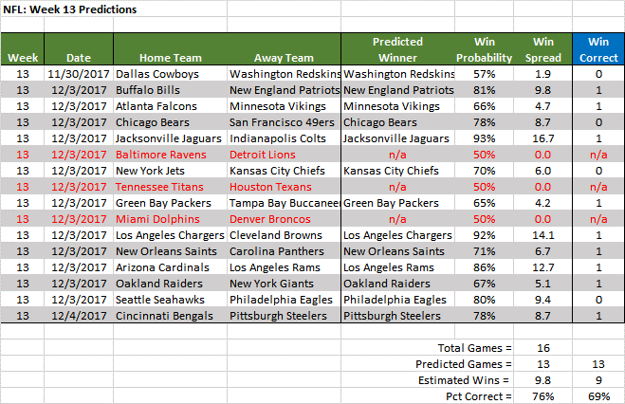
NFL Results

Slide 5
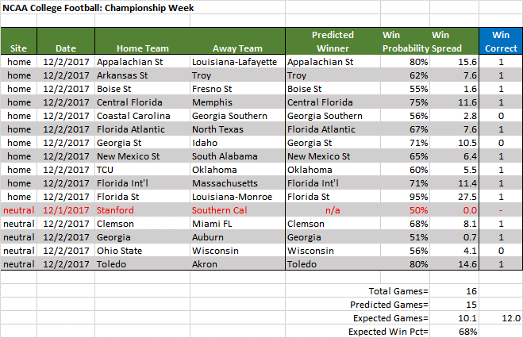
NCAA Results

Slide 6
Sampling Techniques

Slide 7
Sampling Techinques
With Replacement
Lottery with Ping Pong Balls, each number can occur more than once.
Without Replacement
Pick 10 numbers from 100 numbers, each number can only be picked one time.
Jackknife
We can delete one row at a time and estimate the parameters.
Delete one factor and run regression, repeat.
Parameter Estimates
Perform analysis on the sample for a specified number of times, e.g., 25-50.
Estimated Parameter Value = average of all sample parameters.
Standard Error of Parameter = standard deviation of sample parameters divided by number of samples, e.g., stdev/sqrt(n)

Slide 8
Excel Spreadsheet Examples

